Slide 1


Project Presentation
on Image Blurring & Deblurring With Noise Removal
A
Presented By
Aryan Tripathi (1809710025) Azad Khan (1809710034) Manjul Mayank (1809710057)
Guided By
Ms. Arti Ranjan
Department of Computer Science & Engineering Galgotias College of Engineering & Technology , Greater Noida
Dr. A.P.J. Abdul Kalam Technical University, Lucknow, Uttar Pradesh

Slide 2
Outline
Introduction
Abstract
Problem Statement
Drawbacks of Existing System
Proposed Work
System Design
Implementation
Conclusion
References

Slide 3
Introduction
Image blur is used to make an image smooth in which edges are not observed.
Image de-blurring is a process, which is used to make pictures sharp and useful by using mathematical model. Image de-blurring have wide applications from consumer photography.
Image blur is also caused either by the camera motion or by the object motion or focusing inaccuracy.
While taking picture (time of capturing), noise may occur as because of Focus blurring.
Blurring due to camera motion when we zoom an image it produce blurred image with loss of information.
Blurring in image is also caused by inaccurate focusing on any object.
So to get the best quality image with sharp edges we will use machine learning algorithm (SRCNN) for deblurring of the image.

Slide 4
Abstract
We propose a deep learning method for image super resolution (SR). Our method directly learns an end-to-end mapping between the low/high-resolution images.
Unlike traditional methods that handle each component separately, our method jointly optimizes all layers. Our deep CNN has a lightweight structure, yet demonstrates state-of-the-art restoration quality, and achieves fast speed for practical on-line usage.

Slide 5
Problem Statement
Image blur is difficult to avoid in many situations and can often ruin a photograph.
Image de-blurring is a process, which is used to make pictures sharp and useful by using mathematical model. Image de-blurring have wide applications from consumer photography.
E.g., remove motion blur due to camera shake, to radar imaging and tomography.
For effectual analysis and diagnosis of medical images, image de-blurring is the essential step. While acquiring, medical images usually get corrupted by noise and blur.

Slide 6
Drawback of Existing System:
Performance Issues (Accuracy)
Suffers from High Computational Complexity (Complex Mathematical Formulae)
Display poor results concerning the variability of blurring filters and noise of images.
Previous approaches rely heavily on certain assumptions about the properties of the original de-convoluted image.

Slide 7
The goal of this project, Image Deblurring is to recover a high resolution image (de-blurred image) from a low resolution input (blurred image). To accomplish this goal, we will be deploying super-resolution convolutional neural network (SRCNN) The mapping is represented as a deep convolutional neural network (CNN) that takes: Input: low-resolution image (Blurred and noisy image) Output: high-resolution image (Deblurred image) ADVANTAGES: Overcome the drawbacks of existing or traditional researches. Proven High Accuracy. Memory and Time Efficient.
Proposed System and its Advantages:

Slide 8
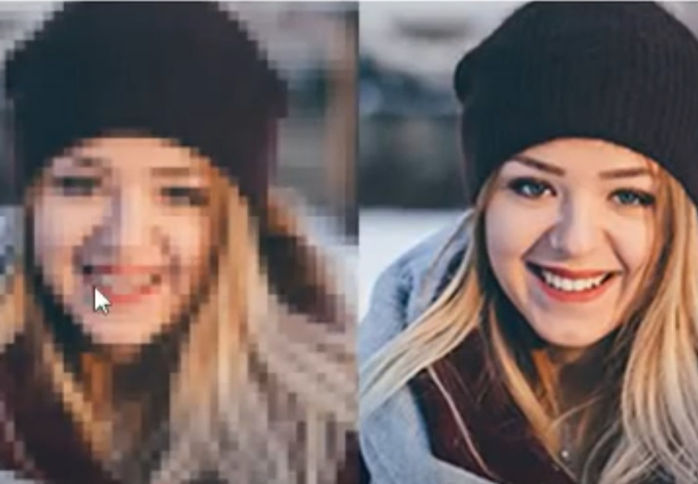
Blurred Image
De-blurred image

Slide 9
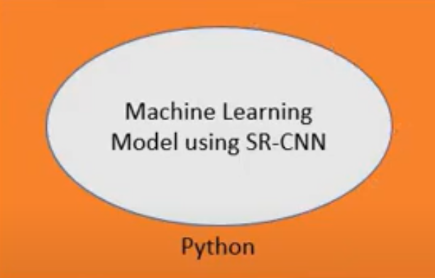
System Design
Blurred Image(Low Resulation)
Deblurred Image(High Resulation)

Slide 10
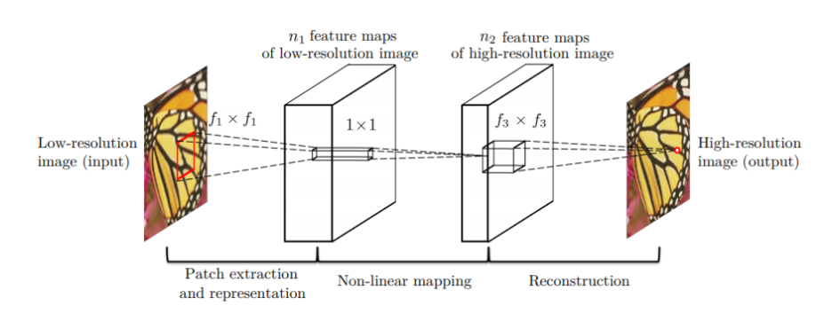
Implementation
The SRCNN architecture has a total of three Convolutional layers. The following two figures summarize the architecture of SRCNN.

Slide 11
1. Patch extraction and representation: This operation extracts (overlapping) patches from the low-resolution image and represents each patch as a high-dimensional vector. These vectors comprise a set of feature maps, of which the number equals to the dimensionality of the vectors. 2. Non-linear mapping: This operation nonlinearly maps each high-dimensional vector onto another high-dimensional vector. Each mapped vector is conceptually the representation of a high-resolution patch. These vectors comprise another set of feature maps. 3. Reconstruction: This operation aggregates the above high-resolution patch-wise representations to generate the final high-resolution image. This image is expected to be similar to the ground truth .

Slide 12
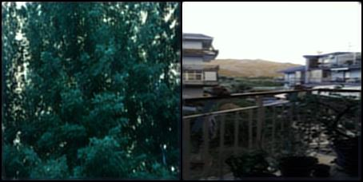
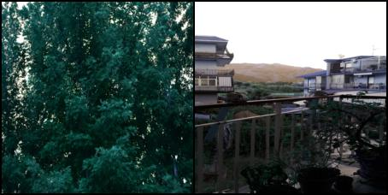
Output
After 10 epochs
After 40 epochs(Deblurred Image)

Slide 13
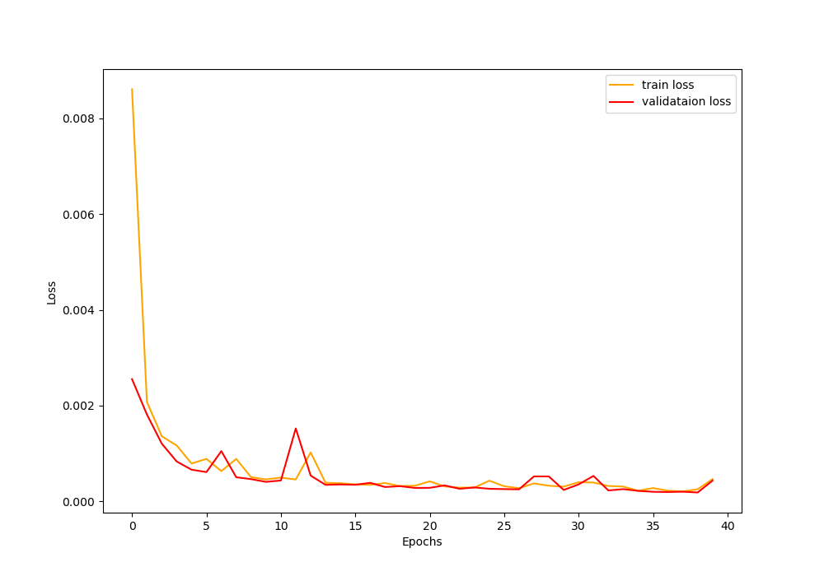
Loss Function

Slide 14
Future scope
We intend to expand our approach to other image deblurring applications in the future, such as deblurring videos, out-of-focus deblurring, and so on.

Slide 15
Conclusion
We have presented a novel deep learning approach for single image super-resolution (SR). The proposed approach, SRCNN, learns an end-to-end mapping between low- and high-resolution images, with little extra pre/post-processing beyond the optimization. The SRCNN has achieved superior performance with a lightweight structure than the state-of-the-art methods.
We conjecture that additional performance can be further gained by exploring more hidden layers/filters in the network, and different training strategies.

Slide 16
References
[1] Sun, Y., Chen, Y., Wang, X., Tang, X.: Deep learning face representation by joint identification-verification. In: Advances in Neural Information Processing Systems. pp. 1988–1996 (2014)
[2] Szegedy, C., Reed, S., Erhan, D., Anguelov, D.: Scalable, high-quality object detection. arXiv preprint arXiv:1412.1441 (2014)
[3] Timofte, R., De Smet, V., Van Gool, L.: Anchored neighborhood regression for fast example-based super-resolution. In: IEEE International Conference on Computer Vision. pp. 1920–1927 (2013)
[4] Timofte, R., De Smet, V., Van Gool, L.: A+: Adjusted anchored neighborhood regression for fast super-resolution. In: IEEE Asian Conference on Computer Vision (2014)
[6] Yang, C.Y., Huang, J.B., Yang, M.H.: Exploiting self-similarities for single frame supe-resolution. In: IEEE Asian Conference on Computer Vision, pp. 497–510 (2010)
[7] Yang, C.Y., Ma, C., Yang, M.H.: Single-image super-resolution: A benchmark. In: European Conference on Computer Vision, pp. 372–386 (2014)
[8] Yang, J., Lin, Z., Cohen, S.: Fast image super-resolution based on in-place example regression. In: IEEE Conference on Computer Vision and Pattern Recognition. pp. 1059–1066 (2013)

Slide 17
Thank you

